Slide 1

Ninja Customer Care
Customer Service
(NCC NUTRA TRAINING)
TRAINING 2026 – DAY 1

Slide 2
Nutra Inbound 5-Day Agent Onboarding Program
By the end of the 5-day training, trainees are expected to:
Demonstrate a strong understanding of NCC processes and policies
Apply the call engine confidently in different call scenarios
Handle customer interactions with the correct agent mindset and communication skills
Execute save, refund, and compliance procedures accurately
Be fully prepared to transition into nesting/production

Slide 3
SECTION 1 — AGENT MINDSET
NCC Overview
This is not a standard call center job. NCC agents are the revenue protection layer for Nutra brands. Every call you handle either protects a customer relationship or ends it.
Nutra inbound is hard work. Customers call confused, frustrated, or upset — most of the time reacting to a charge they didn't fully understand or a product that didn't meet their expectations. That is not your fault. But it is your job to stabilize it. You are not here to defend the product, enforce policy, or win arguments.
You are here to lower the temperature, close the loop, and prevent bigger problems. When you do that well, customers don't call back, disputes don't get filed, and the business stays healthy.

Slide 4
SECTION 1 — AGENT MINDSET
3 CONCEPTS:
EVERY CALL:
Resolve, don't resist. Close the loop. Protect the business — and yourself
The goal of the call is resolution—not winning an argument. Focus on solving the problem in a way that protects both the customer and the business.
2. Refunds are tools, not failures
Refunds are tools, not failures. A 25% adjustment today can prevent a chargeback tomorrow. Chargebacks cost far more than refunds — in fees, MID health, and client relationships. Using refunds correctly and within authority is part of doing this job well.
A refund issued correctly = good judgment. A chargeback that could have been prevented = a failure. Always ask: Is the risk of this customer going to their bank higher than the cost of this refund? If yes — resolve it now.

Slide 5
SECTION 1 — AGENT MINDSET
3. Escalation is support, not failure
Escalation is support, not failure. Escalating early on a genuine risk signal prevents chargebacks and repeat calls. But escalating just to end a difficult call wastes supervisor capacity and shows up in your escalation rate KPI. Know the difference.
Right escalation: customer says 'I'm calling my bank right now' → escalate immediately. Wrong escalation: customer is upset but hasn't threatened anything → handle it, save it, close it yourself.

Slide 6
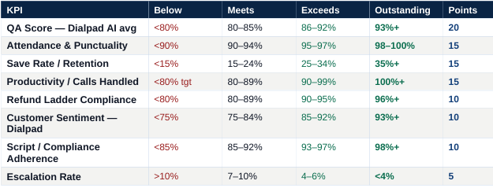
SECTION 2 — YOUR KPIs AND WHAT MOVES THEM
You are scored monthly on a 100-point scale. Your score determines your bonus tier. Every KPI maps to specific behaviors on calls — this is not abstract.

Slide 7
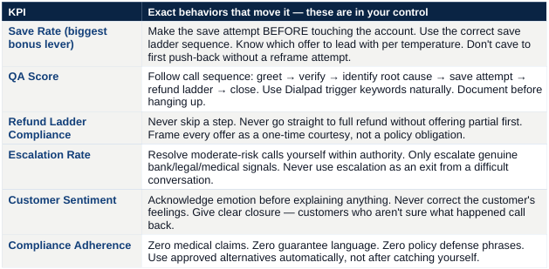
Section 2: KPIs
What actually moves each KPI

Slide 8
Section 3: Call Engine
Every inbound Nutra call follows this sequence. Do not skip steps. Do not reorder them. The sequence is designed so that billing is addressed before you explain anything — a customer who knows future billing is stopped is a calmer customer who is more open to a reasonable resolution.
SEQUENCE: Greet → Verify → [Continuity sub-step if needed] → Classify call type → Stop billing (billing/refund calls only) → Identify root cause → Read temperature → Choose path → Save attempt → Refund ladder if needed → Clear closure → Document.

Slide 9
SEQUENCE:
1.Opening
Opening A — Neutral / calm caller (most calls)
Opening B — Pre-escalated caller (already hot when they connect)
2.Verify → [Continuity sub-step if needed]
zip code and first and last name
Complete shipping address
Classify call type
General question / tracking
Cancellation
Subscription confusion
Refund request
Threat / escalation
Dispute already filed
3.Stop billing (billing/refund calls only)
4.Identify root cause
5.Read temperature -Choose path
-Green - Path A
-Amber - Path B
-Red - Path C
6.Clear closure (Recap)
7.Document.

Slide 10
Section 3: Call Engine
Step 1 — Opening
Two opening paths. Use the correct one within the first 3 seconds based on what you hear when the call connects.
Opening A — Neutral / calm caller (most calls)
  Standard greeting. Caller is quiet, waiting for you, no immediate hostility.
AGENT:
“Thank you for calling [Brand] support, this is [Agent name]. How can I help you today?”
Do not say the product name before verifying. Do not say 'I see you have a problem.' Open neutral. Let them tell you.

Slide 11
Section 3: Call Engine
Opening B — Pre-escalated caller (already hot when they connect)
  Caller connects mid-complaint, raises their voice immediately, or opens with a threat or demand. You can hear it in the first second. Do not use the standard greeting — it reads as tone-deaf and the call escalates faster.
[Let them speak first if they are already talking. Do not interrupt.] [When there is a natural break:]
“I hear you — and I am glad you called. Let me take a look at your account right now and make sure we get this sorted out. “
[If they do not pause:]
“I completely hear you. Can I get your name so I can pull up your account and get this resolved?”

Slide 12
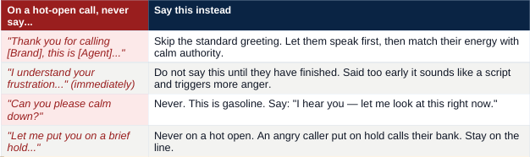
HOT-OPEN RULE: Your first job on a hot-open call is not to solve the problem. It is to be the first person today who listened without arguing. When the customer feels heard, their temperature drops 2–3 points automatically. That drop is what makes everything else possible.

Slide 13
Step 2 — Verification
AGENT:
“Before I pull up your account, can I confirm your name and ZIP code? ... Perfect, I can see your order. How can I help?”
Dialpad AI listens for: verify, confirm, date of birth, last four, address. Use at least one — it scores your verification checkpoint.

Slide 14
Step 2b — Subscription and continuity call protocol
When you hear continuity-related language — rebill, subscription, auto-ship, recurring charge — this sub-step activates. Continuity calls are the second-highest volume call type after WISMO and the highest compliance risk. They need a specific sequence.
WHAT IS CONTINUITY: After the first order ships, the account is set up to continue shipping on a recurring schedule unless canceled. Many customers do not fully register this during checkout. Your job is to handle the confusion without blaming the customer and without defending the checkout page.

Slide 15
Step 2b
The approved continuity explanation
AGENT:
“After the initial order, the account is set up to continue on a recurring basis — that is standard for this type of program. I completely understand that this was not clear. I have already closed the account so there will be no further charges or shipments. Now let me make sure you are fully taken care of on this charge.”
NEVER SAY: 'You agreed to this.' / 'It was in the terms.' / 'You checked the box.' / 'It was in the fine print.' These are compliance violations AND they instantly escalate every continuity call from medium to high risk. Never cite the terms to a confused customer.

Slide 16
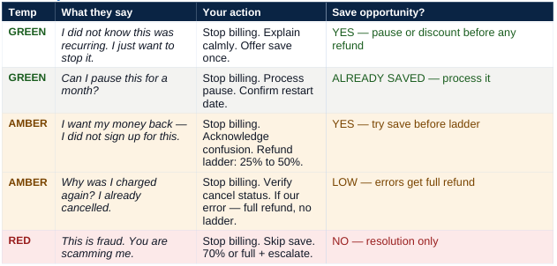
Continuity call decision tree

Slide 17
Continuity-specific save offers
Offer
Script
When to use
Skip next shipment
"What I can do is skip the next scheduled shipment so you have more time with what you have. Nothing ships, nothing charges."
Customer who has product on hand and is not opposed to it — just surprised by the cadence.
Extend billing cycle
"I can shift you to every 60 or 90 days — same program, less frequent. Would that feel more manageable?"
Customer who likes the product but says shipments come too fast.

Slide 18
Continuity-specific save offers
Offer
Script
When to use
Pause 30–60 days
"I can put the account on pause — nothing charges during that time. You can call back to resume or cancel before it restarts."
Customer who is undecided. Pause keeps the account open without pressure.
Downgrade + continue
"I can adjust your shipment to the smaller 2-bottle option — lower cost, same program. Brings the recurring charge down to about $119."
Customer whose objection is cost, not concept. They would stay at a lower price.
CONTINUITY SAVE INSIGHT: Most continuity callers who cancel would have accepted a skip, pause, or frequency change if it had been offered clearly and without guilt. Most agents go straight to cancellation because they assume the customer wants to leave. Ask before you cancel.

Slide 19
Step 3 — Stop future billing (billing and refund calls only)
AGENT:
“I've gone ahead and closed the account so there will be no future charges or shipments.”
[Pause — let that land]
Do NOT explain the subscription before stopping billing. Do NOT defend the checkout. Do NOT run this step on WISMO or product question calls — see Step 3 call classification. On billing and refund calls: stop billing first, explain second.

Slide 20
Step 4 — Identify root cause (billing and refund calls)
AGENT:
“Now that we've got that sorted — can you help me understand what happened? Was it the charge amount, something about the product, or something else?”
[PAUSE — wait for full answer. Do not interrupt. Their answer tells you which path you're on.]
Dialpad AI listens for: I understand, the reason, what happened, let me look into. Let them explain fully before responding.

Slide 21
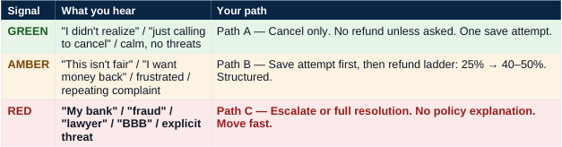
Step 5 — Read temperature and choose path (billing and refund calls)
Step 6 — Clear verbal closure
AGENT:
“To recap: your account is closed and there will be no future charges. [If refund:] The adjustment of [amount] will reflect within 3–5 business days. This resolves the issue on our end. Is there anything else I can help with today?”

Slide 22
Step 7 — Document before hanging up
AGENT:
[Into CRM]
Customer concerned about [reason]. Account canceled. [Courtesy adjustment of X% issued / No refund issued.] No future billing. Resolved.
Dialpad AI listens for: noted, I've updated, recorded, documented. Say one of these during the call.

